Slide 1
Coal-rich States Example: Montana

Slide 2
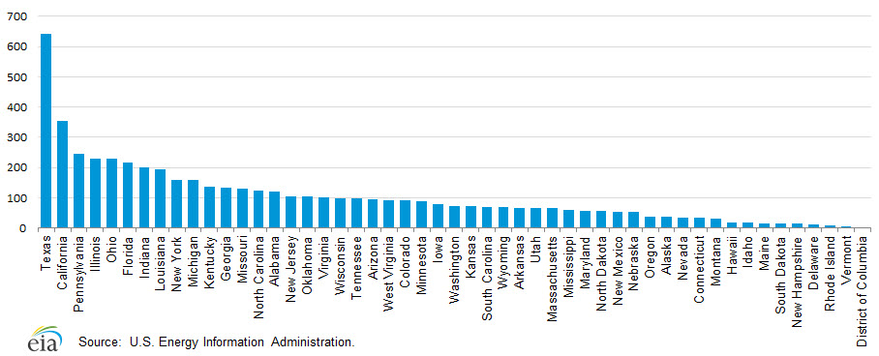
How Montana Compares
Price on Carbon
Montana 2013 emissions were 0.60% of total U.S. emissions
Natural
Gas
14%
Coal
49%
Million metric tons CO₂ (2013)
Petroleum
37%

Slide 3
What CPP Means for MT
Price on Carbon
Required to reduce by 47% (largest in U.S.)
Eight affected units in five facilities (4 in Colstrip account for 80% of emissions) - other major power source is hydro
Job loss, community loss
Tiny effect on total emissions
Asking for sacrifice for benefit of others
Change to way of life, hardship

Slide 4
Change the Message
Price on Carbon
Bring it home – health, agriculture, forestry
Coal market is declining, move to other opportunities
Switch quickly to positive – weaken emotion in opposition
Renewables are the opportunity, bright future
Focus on Opportunity

Slide 5
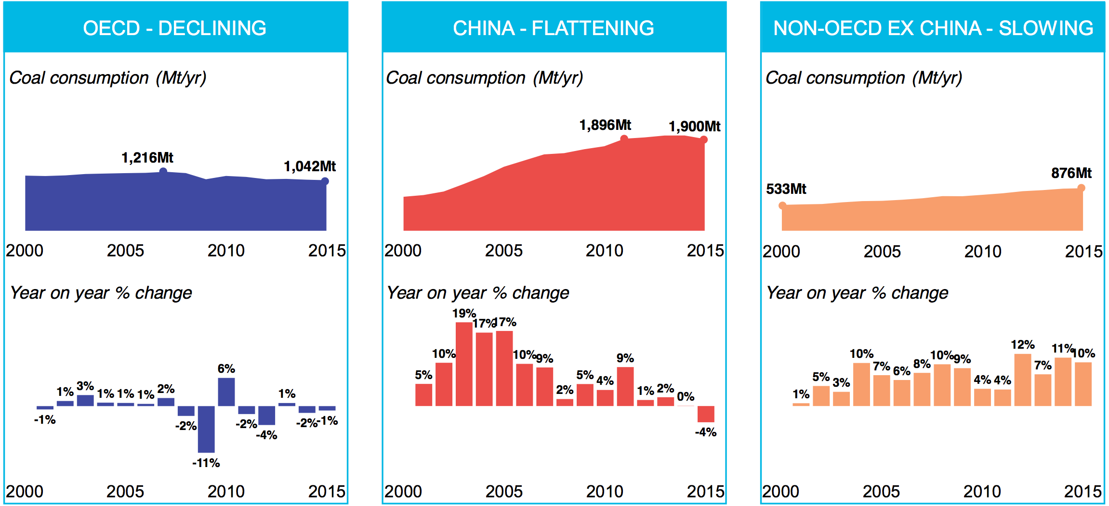
Coal Consumption
Price on Carbon

Slide 6
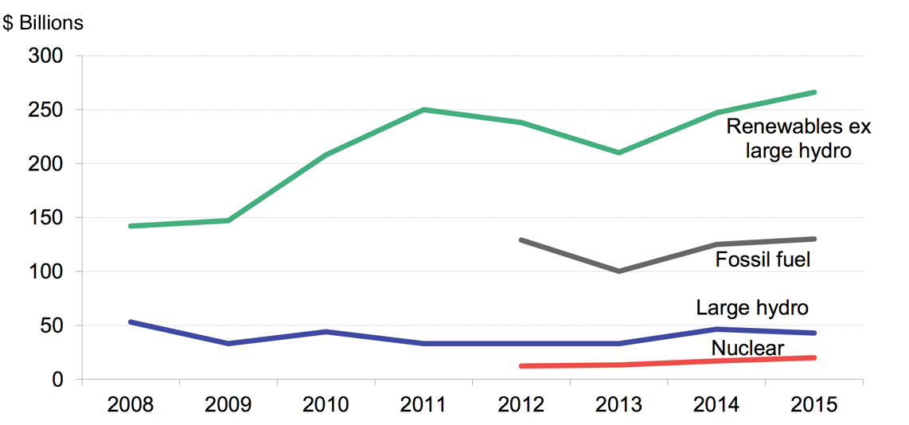
Renewables Investment
Price on Carbon
U.S. Investment
Source: Bloomberg New Energy Finance
Growing even in low oil price market

Slide 7
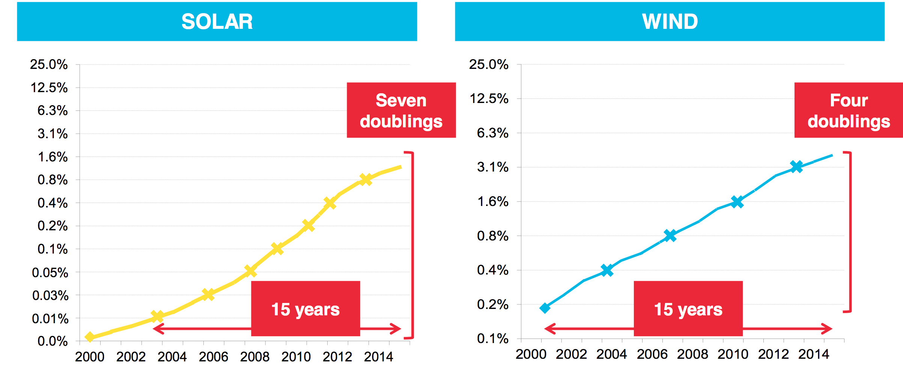
Renewables Growth
Price on Carbon
Renewables’ share of power generation. Scale is shown in doublings.
Source: Bloomberg New Energy Finance

Slide 8
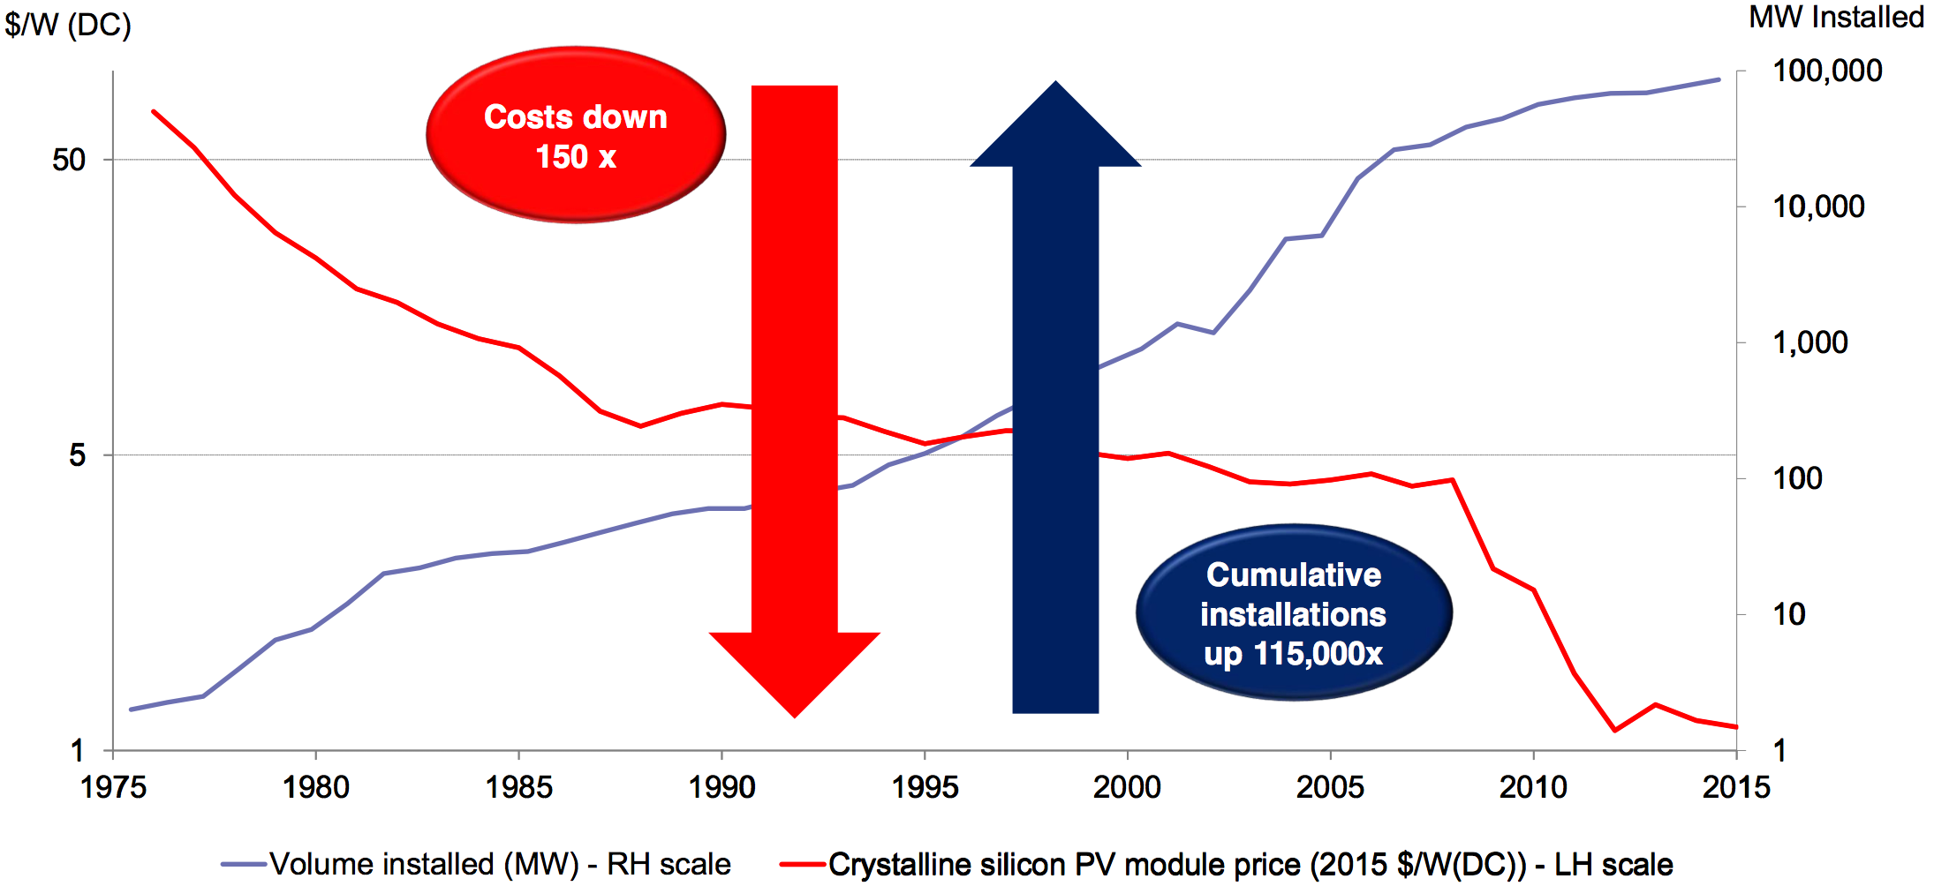
Renewables Future
Price on Carbon

Slide 9
Key Learnings
Price on Carbon
Bring the message home – focus on local effects
Inevitable change in markets globally
Take it quickly to the positive – a better, cleaner world
Renewables opportunities, carbon pricing advantages
Grab a big share of the upside
Proof in the Pudding:
Very positive response from Republican Congressional staff

Slide 10
More Progressive States Example: Massachusetts

Slide 11
Massachusetts
Price on Carbon
Regional Greenhouse Gas Initiative (RGGI): 2005
Global Warming Solutions Act: 2008
Reduce from 1990 levels by 25% by 2020, 80% by 2050
Not on track
Massachusetts Supreme Court Ruling: May, 2016
On behalf of “Our Children’s Trust” http://ourchildrenstrust.org/
National (and international) push to use the court system
Carbon pricing legislation submitted: 2013 and 2015

Slide 12
Massachusetts Emissions
Price on Carbon
2014
Other
Transportation and heating are largest source of emissions: 39% and 30% respectively
RGGI only caps power plants (electricity): 21%
Carbon pricing legislation under consideration addresses transportation and heating
Electricity
Transportation
Heating
Analysis of a Carbon Fee or Tax as a Mechanism to Reduce GHG Emissions in MA,
Mass Department of Energy Resources (DOER), December 2014

Slide 13
Key Learnings
Price on Carbon
Build broad, multi-sector advocacy coalition
Find common ground
Public education
Statewide public forums
Steering committees
Be aware of related energy efforts
Notes:
How does all this relate to carbon pricing?
Massachusetts is one of the nine NE and Mid-Atlantic states included in the 2005 Regional Greenhouse Gas Initiative, also known as RGGI, a market-based, multi-state regulatory carbon pricing program using a cap and trade approach, designed to reduce emissions from power plants. While RGGI has been an effective tool in reducing emissions, it is not enough to achieve the level of reductions mandated.
The graph on this slide comes from a 2014 Massachusetts Department of Energy Report on the impact of a carbon fee in MA. It shows the percentage of total GHG Emissions in 2011 by sector. The biggest slice of the emissions’ pie comes from transportation – the blue section - and heating - the red section. Emissions from electricity generation are covered by the Regional Greenhouse Gas initiative, represented in green.
This graph shows that in MA, the largest portion of emissions come from the transportation and heating sectors, sectors not covered by RGGI. In the landmark case referenced on the last slide, the Court ruled unequivocally that aggregate emissions from RGGI participation are not applicable to the mandates of the 2008 MA Global Warming Solutions Act. The MassDEP is required to promulgate regulations from a variety of categories and sources of emissions within the state.
The Department of Energy report also found that implementing a carbon fee in Massachusetts could reduce emissions at the 2050 target level, by 2035 -- 15 years ahead of schedule (80% below 1990 level).
The first fee and rebate carbon pricing legislation in the nation was introduced in Massachusetts during the 2013-2014 legislative session to supplement existing programs and drive changes in behavior and the market toward greater energy efficiency and clean, renewable energy. This session, there are two fee and rebate systems pending in the legislature. While both bills would establish a carbon fee on carbon emissions equivalents, one bill is 100% revenue neutral – meaning all revenue collected would be returned to residents and businesses. The other bill would allow for a 20% carve out for reinvestment in renewable energy and energy efficiency programs. The League of Women Voters of Massachusetts supports carbon fee and rebates, with or without a carve out.
REFERENCES
2014 DOER report:
Analysis of a Carbon Fee or Tax as a Mechanism to Reduce GHG Emissions in Massachusetts
Prepared for the Massachusetts Department of Energy Resources December 2014: http://www.mass.gov/eea/docs/doer/fuels/mass-carbon-tax-study.pdf

Slide 14
Delaware Price on Carbon (DEPOC) Study

Slide 15
DEPOC Study
Price on Carbon
Vulnerability
Delaware is especially vulnerable to sea level rise and coastal storms; it has a long coastline and the lowest mean elevation of any state in the U.S. (~60 ft).
According to James Hansen, 450±100 ppm CO₂ is enough, in time, to melt all the ice now on land.
Total melting would take centuries, but significant sea level rise could happen in decades

Slide 16
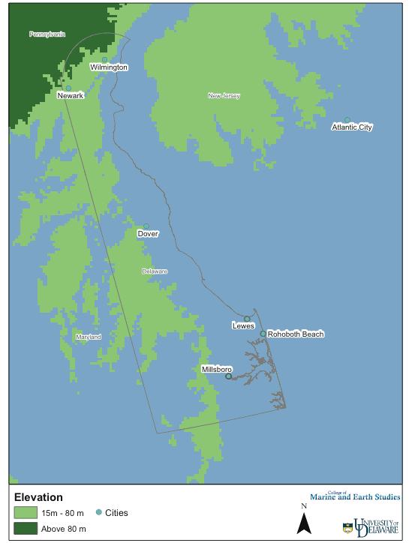
Impacts of 15 m and 80 m Sea Level Rise on DE, MD and NJ
Willett Kempton
Univ. of DE
Notes:
From Figure 8 in W. Kempton et al., Sea Level Rise and its Effect on Delaware.
At: http://co2.cms.udel.edu/SeaLevel_DE.htm

Slide 17
DEPOC Study
Price on Carbon
Background
LWVDE introduced the Price on Carbon Resolution at the LWVUS Convention 2014.
Delaware is a member of the 9-state RGGI, which has decreased carbon emissions from power plants by 40% since 2009 – even though emission allowances have sold for <$7/ton of CO2.
Most of the funds raised through RGGI have been used to promote energy efficiency and develop renewable energy.

Slide 18
DEPOC Study
Price on Carbon
Key Conclusions
Delaware is very vulnerable to climate change – especially to sea level rise and coastal storms.
Delaware has significantly reduced its carbon emissions – partly through RGGI and partly because all power plants but one have switched from coal to natural gas.

Slide 19
DEPOC Study
Price on Carbon
Key Learnings
Transportation is now the largest source of carbon emissions in Delaware and the other RGGI states.
U.S. Vehicle Miles Traveled have have not changed much in recent years even though gasoline prices have dropped by more than $2/gallon. (A gas tax of $2/gal is equivalent to a carbon price of $200/ton of CO₂.)
The way money raised by carbon pricing is used can have a large effect on carbon emissions.

Slide 20
Key Learnings
Price on Carbon
Collaboration among Leagues and with other organizations is key to successfully addressing climate change.
An essential role for Leagues and others is educating the public and policy makers on the threat climate change poses and the opportunities it presents.

